Slide 1
Testing OpenMRS Modules
With JUnit and Spring

Slide 2
Why test?
Like any software, we need to KNOW it works the way it should
Testing helps you out
It helps you think about what your code is doing
It’s faster than loading a module every time you add functionality

Slide 3
What should you test?
Generally, you should:
Write tests for your domain objects
Write tests for each of your controllers
Write tests for each of your service methods

Slide 4
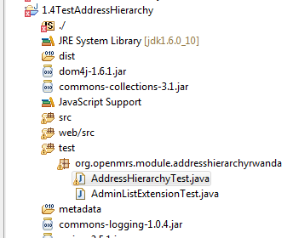
Test Classes and Package
Test package
Testing class for service methods

Slide 5
JUnit Assert Statements
Statement | Description
fail(String) | Let the method fail, might be usable to check that a certain part of the code is not reached.
assertTrue(true); | True
assertsEquals([String message], expected, actual) | Test if the values are the same. Note: for arrays the reference is checked not the content of the arrays
assertsEquals([String message], expected, actual, tolerance) | Usage for float and double; the tolerance are the number of decimals which must be the same

Slide 6
Statement | Description
assertNull([message], object) | Checks if the object is null
assertNotNull([message], object) | Check if the object is not null
assertSame([String], expected, actual) | Check if both variables refer to the same object
assertNotSame([String], expected, actual) | Check that both variables refer not to the same object
assertTrue([message], boolean condition) | Check if the boolean condition is true.

Slide 7
JUnit TestCase
public class AdminListExtensionTest extends TestCase {
public void testValidatesLinks() {
AdminList ext = new AdminList();
Map<String, String> links = ext.getLinks();
assertNotNull("Some links should be returned", links);
assertTrue("There should be a positive number of links", links.values().size() > 0);
}
public void testMediaTypeIsHtml() {
AdminList ext = new AdminList();
assertTrue("The media type of this extension should be html", ext.getMediaType().equals(MEDIA_TYPE.html));
}
}

Slide 8
JUnit Annotations
Annotation | Description
@Test public void method() | Annotation @Test identifies that this method is a test method.
@Before public void method() | Will perform the method() before each test. This method can prepare the test environment, e.g. read input data, initialize the class)
@After public void method() | Test method must start with test
@BeforeClass public void method() | Will perform the method before the start of all tests. This can be used to perform time intensive activities for example be used to connect to a database

Slide 9
Annotation | Description
@AfterClass public void method() | Will perform the method after all tests have finished. This can be used to perform clean-up activities for example be used to disconnect to a database
@Ignore | Will ignore the test method, e.g. useful if the underlying code has been changed and the test has not yet been adapted or if the runtime of this test is just to long to be included.
@Test(expected=IllegalArgumentException.class) | Tests if the method throws the named exception
@Test(timeout=100) | Fails if the method takes longer then 100 milliseconds

Slide 10
JUnit TestCase with Annotations
public class AppointmentWithTestCaseTest {
private Appointment appointment;
@Before
public void setUp() throws Exception {
appointment = new Appointment();
}
@After
public void tearDown() throws Exception {
appointment = null;
}

Slide 11
@Test
public void testReason() {
String reason = appointment.getReason();
String reasonText = "I need an appt!";
assertNull("Reason should be null", reason);
appointment.setReason(reasonText);
reason = appointment.getReason();
assertNotNull("Reason should not be null", reason);
assertTrue("Reason should be "+ reason, reason.equals(reasonText));
}
}

Slide 12
JUnit TestSuite
You can run each test manually one by one.
If you have a large number of tests, this becomes time-consuming.
Use a Test Suite to automatically group tests and run them together.

Slide 13
JUnit Test Suite
import junit.framework.Test;
import junit.framework.TestSuite;
public class AllTestsOld {
public static Test suite() {
TestSuite suite = new TestSuite("Test for org.openmrs.module.appointments");
//$JUnit-BEGIN$
suite.addTestSuite(AdminListExtensionTest.class);
//$JUnit-END$
return suite;
}
}

Slide 14
Junit Test Suite with Annotations
package org.openmrs.module.appointments;
import org.junit.runner.RunWith;
import org.junit.runners.Suite;
@RunWith(Suite.class)
@Suite.SuiteClasses({
AdminListExtensionTest.class,
AppointmentWithTestCaseTest.class
})
public class AllTests {
}

Slide 15
Testing OpenMRS Services
If you want to test your services or anything that uses the Context class:
You must extend BaseModuleContextSensitiveTest
OpenMRS has a testing framework:
Need to use it if you want to test services!
Sets up the database connections for you and initializes the context services

Slide 16
Extend BaseModuleContextSensitive
Two Options
Use a Dynamically Created In - Memory Database
Use database specified by runtime properties file
Required Configuration
You must put the three OpenMRS jars on your buildpath
You must put all the jars that OpenMRS uses on your buildpath as well!

Slide 17
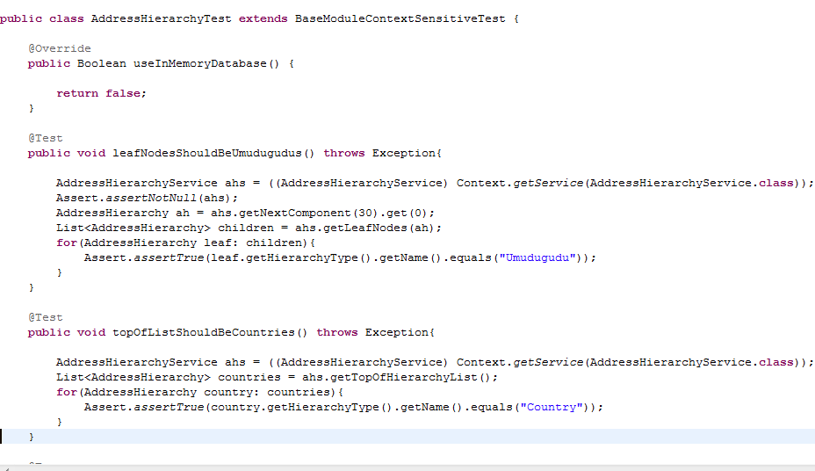
Example: Extending BaseModuleContextSensitiveTest
Forces use of database specified by the runtime properties file

Slide 18
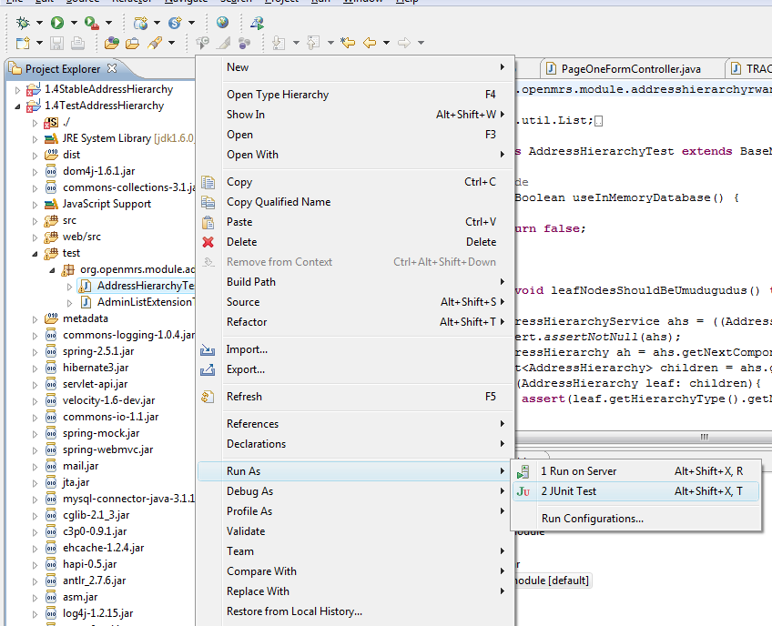

Slide 19
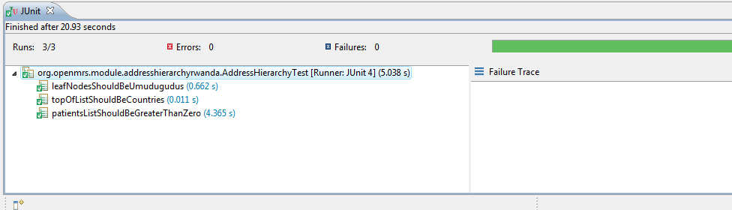
A Successful Junit Run

